Slide 1

Green Pace
Security Policy Presentation
Developer: Spencer Erickson

Slide 2

OVERVIEW: DEFENSE IN DEPTH
The infographic below illustrates the methods of defense our team utilizes to ensure code is both secure and protected from malicious attackers.

Slide 3
THREATS MATRIX
Likely Threats with a high probability of occurring. | Priority Standard with High relevancy.
Low priority Standard with low relevancy. | Unlikely Threats that are less likely to occur.
The chart here displays priorities levels regarding secure coding standards. These levels of threats indicate the impact they would have on the program and company being attacked.

Slide 4
10 PRINCIPLES
• 1. Validate Input Data
• 2. Heed Compiler Warnings
• 3. Architect and Design for Security Policies.
• 4. Keep it Simple
• 5. Default Deny
• 6. Adhere to the Principle of Least Privilege
• 7. Sanitize Data Sent to Other Systems
• 8. Practice Defense in Depth
• 9. Use Effective Quality Assurance Techniques
• 10. Adopt a Secure Coding Standard

Slide 5
CODING STANDARDS
Do not cast to an enumeration value that is outside of range.
Use the correct pointers, references, and iterators.
Do not create a std::string from a pointer that is null.
You should never store a smart pointer value in a pointer that is already owned.
Ensure all resources are properly allocated and deallocated.
When testing a constant expression, you must use a static assertion to test the value.
Prior to executing ensure all exceptions are taken care of.
Do not let exceptions escape from destructors or deallocation functions.
Do not consecutively input and output from a file stream without an intervening positioning call.
Do not change the standard namespaces. This can result in unwanted errors when done incorrectly.

Slide 6
STANDARDS TABLE
Rule | Severity | Likelihood | Remediation Cost | Priority | Level
Rule | Severity | Likelihood | Remediation Cost | Priority | Level
STD-001-CPP | Medium | Unlikely | Medium | Low | 3
STD-002-CPP | High | Probable | High | Medium | 2
STD-003-CPP | High | Likely | Medium | High | 1
STD-004-CPP | High | Likely | Medium | High | 1
STD-005-CPP | High | Likely | Medium | High | 1
STD-006-CPP | Low | Unlikely | High | Low | 3
STD-007-CPP | High | Likely | High | Medium | 2
STD-008-CPP | High | Likely | High | Medium | 2
STD-009-CPP | Low | Likely | Medium | Medium | 2
STD-010-CPP | High | Unlikely | Medium | Medium | 2

Slide 7
ENCRYPTION POLICIES
• Encryption in rest - Encryption at rest provides data protection for stored data or data “at rest”. The company can use this form of encryption to safely protect and stored sensitive data on devices or with in database to include credit card numbers, account numbers, passwords and so on.
• Encryption at Flight - Encryption in flight is a technique used to protect the privacy of communication data as it travels between two points. This form of encryption can be used if employees intend to work from home or a mobile means as well as transferring emails with sensitive information on them.
• Encryption in Use - This is the encryption of data that is being actively used. The encryption provides specific users access to data which can protect this company from lower security level employees accessing information not meant for them.

Slide 8
TRIPLE-A POLICIES
Authentication | Authentication relies on usernames passwords scanners access cards and multi-feature identification to grant users access to information and systems withing the network based on their determined security level.
Authorization | Determines a user’s access within the system based of their authentication information and associated security level with admin access being the higher types of access which will allow the user to modify the database itself or grant access to other users in the database.
Accounting | Accounting will keep record of all the information’s derived from both authorization and authentication as well as any changes made by a user and when they were made. This will aid in accurately tracking changes within a system as well as keep record of who made them so if further questions arise, we will know where to direct our attention.

Slide 9
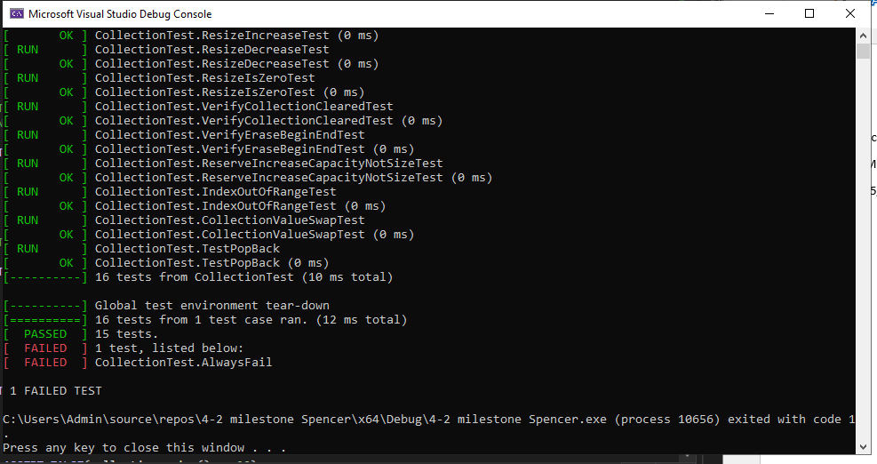
Unit Testing
Unit testing happen from the start and all through out the development process to ensure that we maintain secure functioning code. Attached below is just one example of a unit test ran to ensure maximum code quality.

Slide 10

AUTOMATION SUMMARY

Slide 11
TOOLS
the DevSecOps pipeline is a secure coding methodology that enforces a policy with an infrastructure built on effectively keeping code secure and protected.
Many tools were utilized within testing of the program to include Axivion Bauhaus Suite, CodeSonar, Helix QAC, Parasoft C/C++test, Polyspace Bug Finder, and many more. These tools aided in the continuous evaluation and testing of the program as it underwent development and played an essential role in securing the code and streamlining workflow.

Slide 12
RISKS AND BENEFITS
Acting Now/Acting Later: There are a time and place for these different methods however in my opinion I preferer to act now and only act later if need be. The benefits of acting now include early mitigation of exploits and weakness during program developments as well as avoiding the headache of countless errors and issues arising upon completion of program development. Some benefits worth of mentioning using the act later approach are its speed of program development in the sense it allows you to produce a product quicker not necessarily secure, but it exists. Beyond that It allows for exploits to be more severe and data to be potentially at risk if the program is to be leaked prior to its intended release which leads me to my recommendation of always using the act now approach when developing secure code within a program.

Slide 13
RECOMMENDATIONS
Include two factor identification for users with an account
Provide only certain users with certain permission within the system auditing monthly to ensure security.
Regular unit testing
Routine auditing to monitor changes made within the program by thew users and when it was made.

Slide 14
CONCLUSIONS
In conclusion with all the principals and standards suggested in this presentation I believe we can foster a secure and robust security protocol to better protect Green pace and all its users and customers involved in this program

Slide 15
REFERENCES
SEI CERT Coding Standards - CERT Secure Coding - Confluence. (n.d.). Wiki.sei.cmu.edu.
https://wiki.sei.cmu.edu/confluence/display/seccode/SEI+CERT+Coding+Standards

